Slide 1


Banglore institute of technology
Department of information science and engineering
Database management system-project-18CSL58
Presentation on:
“Minimizing Food Leftovers System”
Under the guidance of: by:
Mrs. Anupama K C Shreedatta Nasik 1BI20IS092
Assistant prof. dept of ISE,BIT Snehit kinagi 1BI20IS103
Mrs. Vani V
Assistant prof. dept of ISE,BIT

Slide 2
Problem statement
In the past few years machine learning has progressed in a substantial manner. Day by day machine learning concepts are being integrated to fields that are not at all related and getting desirable result.
But not many projects are being done on the restaurant field which houses a large amount of data. The major aspect in which the restaurants lose their money and resources is due to the leftovers.
The purpose is to apply the concepts of machine learning and develop a system that predicts the food items that would be consumed and hence reducing the leftovers as it is not completely accurate.
Still the owner can use this data to his advantage and make the necessary arrangements in cooking food items.

Slide 3
Objectives and Scope
Identify the parameters on which each food items are dependent upon
Store the data on those parameters in the database on a certain manner
specified by the schema
Collect the data until required amount.
Processing of data and fitting it with a predicting model
Building an application program which predicts the consumption of food item specified by the parameters passed.

Slide 4
Hardware and software recquirements
Operating System: Windows 7/8/10/11
Back End: python
Front End: HTML, CSS, flask
Application required: Visual Studio and the database used is MYSQL
Hard disk: 15GB/Above
RAM: 1GB/Above
Processor:Intel core i3/i4/i5/i7 or equivalent AMD processors

Slide 5
Implementation
The data in the database is imported into python ide through the package sqlconnector.
The data is read into a dataframe through pandas package.
A linear regression model with multi variable is fitted to all the food items
The parameters are given from the front end.
The regression objects predicts the consumption of food_item based on the sent parameters
The predicted values are then sent back to front end.
Flask frame work is used to connect backend and front end

Slide 6
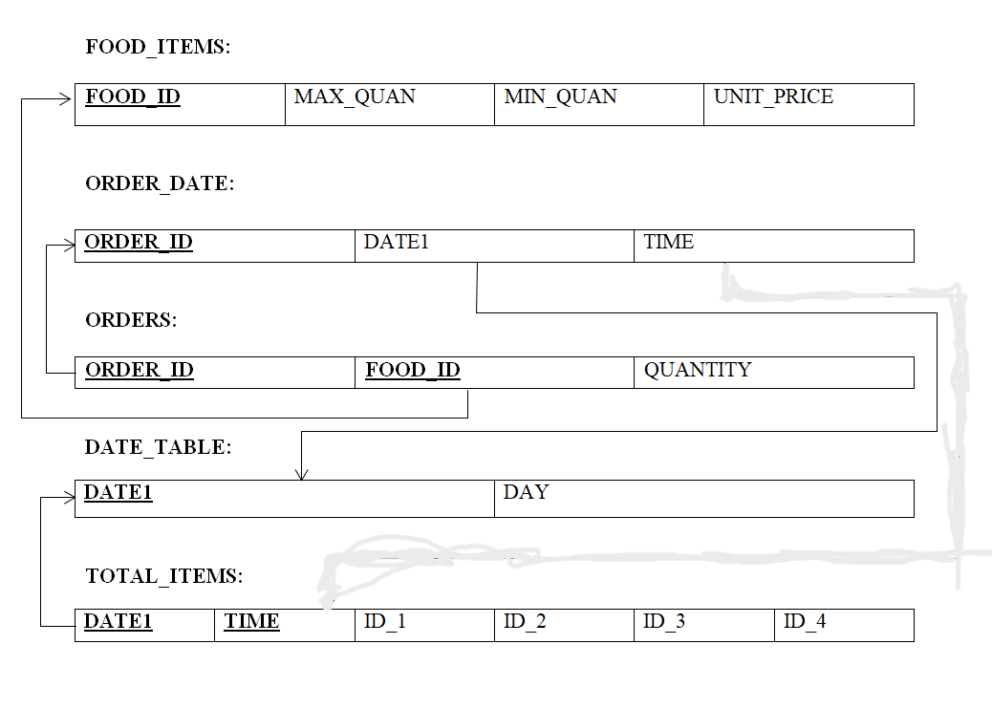
Schema diagram

Slide 7
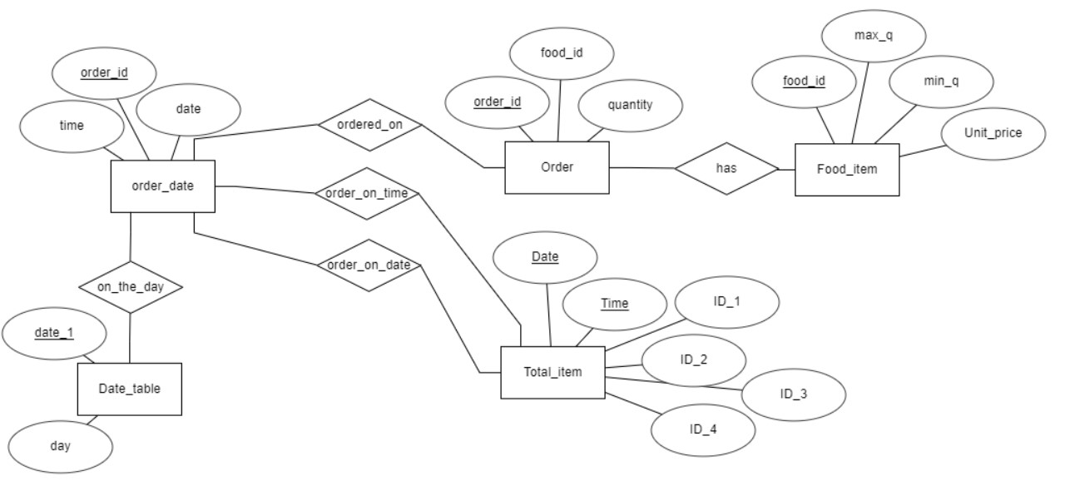
ER Diagram

Slide 8
Stored procedures
1. CREATE DEFINER=`root`@`localhost` PROCEDURE `u1`()
BEGIN
UPDATE total_items M
JOIN orders N ON N.FOOD_ID=1
JOIN order_date O ON M.DATE1=O.DATE1 AND M.TIME=O.TIME
SET M.ID_1=(SELECT SUM(X.QUANTITY)
FROM orders X,order_date Y
WHERE X.FOOD_ID=1 AND
X.ORDER_ID=Y.ORDER_ID AND
Y.DATE1=M.DATE1 AND
Y.TIME=M.TIME)
WHERE N.ORDER_ID=O.ORDER_ID AND
M.TIME=O.TIME;
END

Slide 9
2. CREATE DEFINER=`root`@`localhost` PROCEDURE `UALL`()
BEGIN
CALL u1();
CALL u2();
CALL u3();
CALL u4();
END
3. CREATE DEFINER=`root`@`localhost` PROCEDURE `calldate_table`()
BEGIN
update `date_table` set DAY=day(DATE1);
END

Slide 10
Triggers
1. CREATE DEFINER=`root`@`localhost` TRIGGER `orders_AFTER_INSERT` AFTER INSERT ON `orders` FOR EACH ROW BEGIN
call uall();
END
2. CREATE DEFINER=`root`@`localhost` TRIGGER `order_date_AFTER_INSERT` AFTER INSERT ON `order_date` FOR EACH ROW BEGIN
insert into `date_table` (DATE1) values (date1);END
3. CREATE DEFINER=`root`@`localhost` TRIGGER `date_table_AFTER_INSERT` AFTER INSERT ON `date_table` FOR EACH ROW BEGIN
call calldate_table();
END

Slide 11
View
CREATE
ALGORITHM = UNDEFINED
DEFINER = `root`@`localhost`
SQL SECURITY DEFINER
VIEW `new_view` AS
SELECT
`d`.`DAY` AS `DAY`,
`l`.`TIME` AS `TIME`,
`l`.`ID_1` AS `ID_1`,
`l`.`ID_2` AS `ID_2`,
`l`.`ID_3` AS `ID_3`,
`l`.`ID_4` AS `ID_4`
FROM
(`date_table` `d`
JOIN `total_items` `l`)
WHERE
(`d`.`DATE1` = `l`.`DATE1`)

